Slide 1
Behaviors Governed by circadian & Circannual rhythm
Chapter 39 & 49

Slide 2
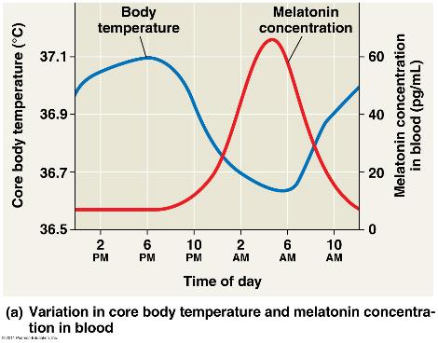
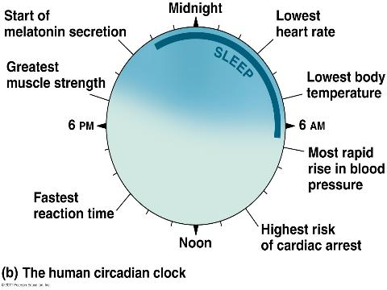
Circadian Rhythm
Physiological cycle that displays an endogenous, entrainable oscillation of about 24 hours.
© 2011 Pearson Education, Inc.

Slide 3
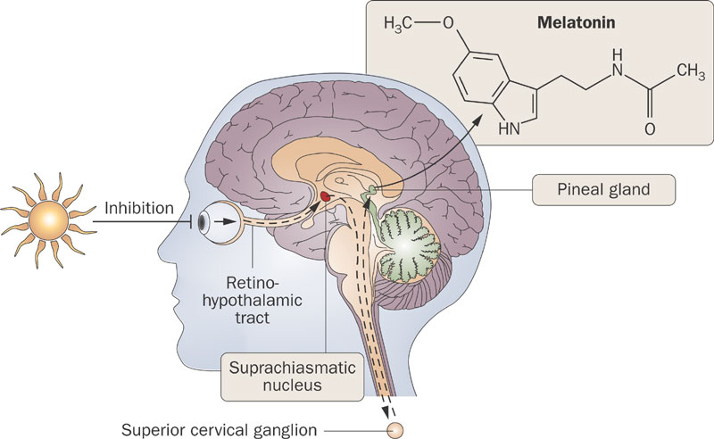
Suprachiasmatic Nucleus (SCN)
© 2011 Pearson Education, Inc.

Slide 4
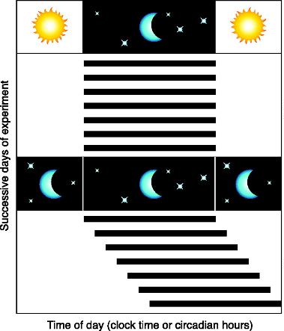
Deviation From 24-Hour Clock
Mouse Actogram Model
© 2011 Pearson Education, Inc.

Slide 5
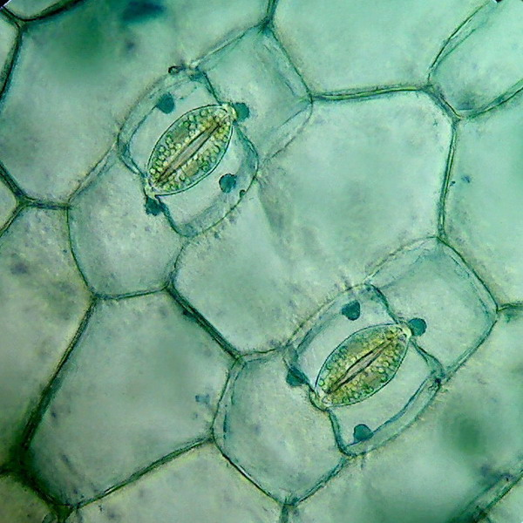
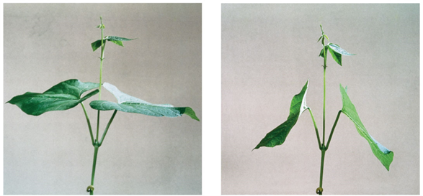
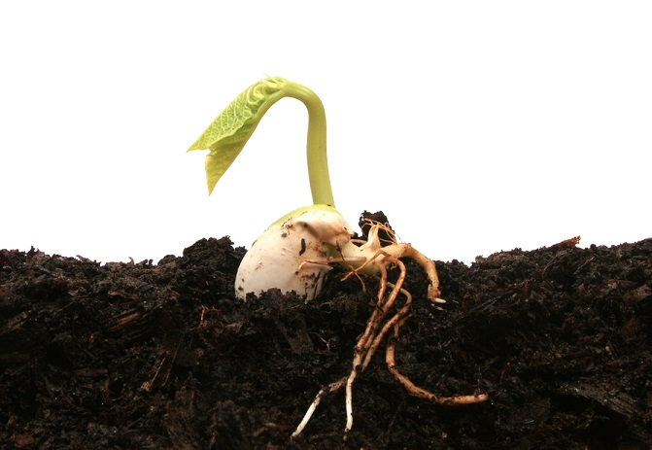
Photoreceptors in Plants
Blue-light photoreceptors
Stomatal opening
Phytochromes
Sleep movements
Seed germination
© 2011 Pearson Education, Inc.

Slide 6
Plant Response to Seasons
Photoperiod
Relative lengths of night and day
Photoperiodism → physiological response
Short-day
Flower when night > day
Long-day
Flower when night < day
Day-neutral
Flowering controlled by plant maturity, not photoperiod
© 2011 Pearson Education, Inc.

